Slide 1

Rawan Ahmed Mohammed Hassan e-commerce website(my store) A website selling electronic devices and making many companies log into their control panel and sell their products

Slide 2
Technical used: frontend=> html & css javascript jquery & ajax
Backend=>
Php
MYSQL

Slide 3
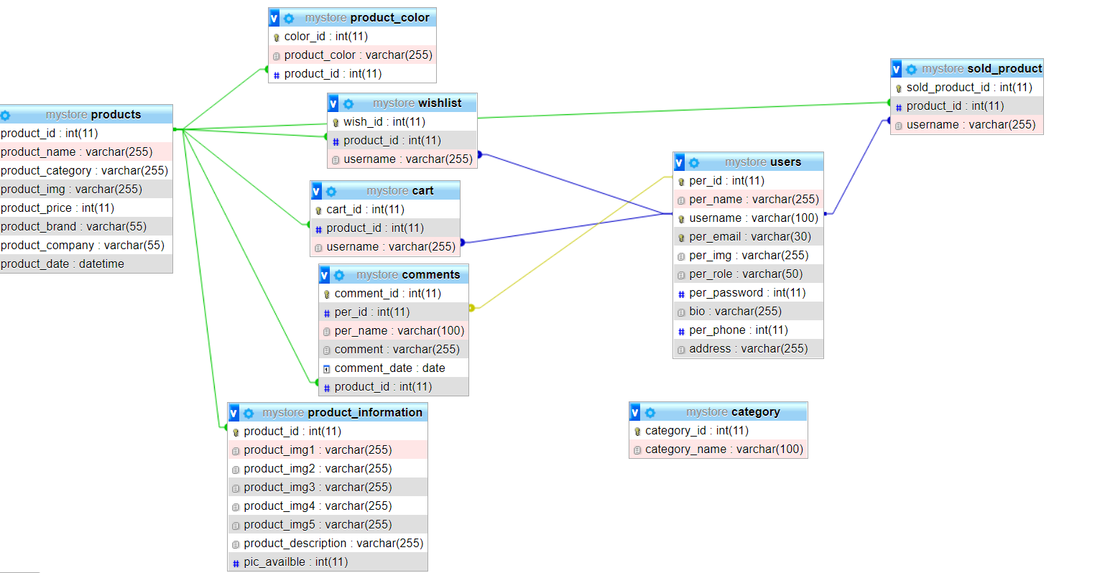
database

Slide 4
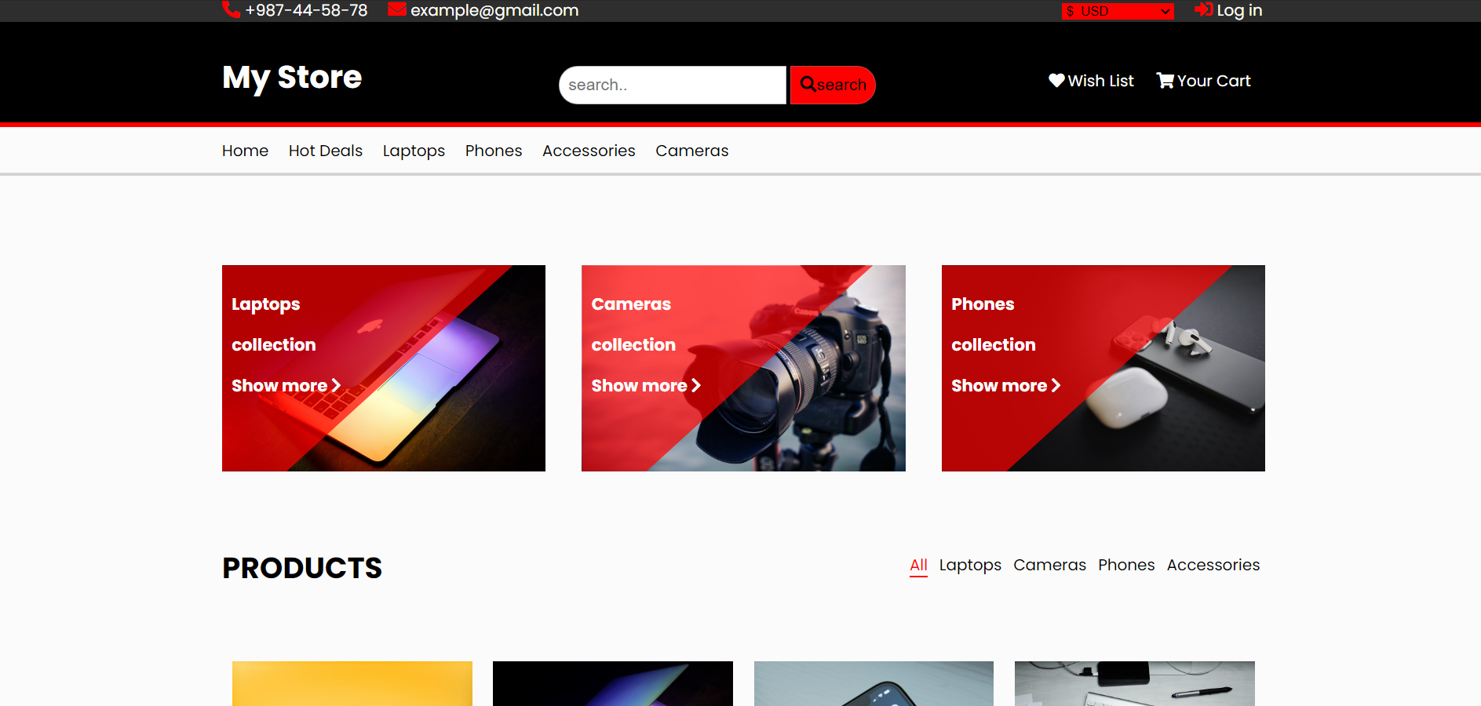
Home site

Slide 5
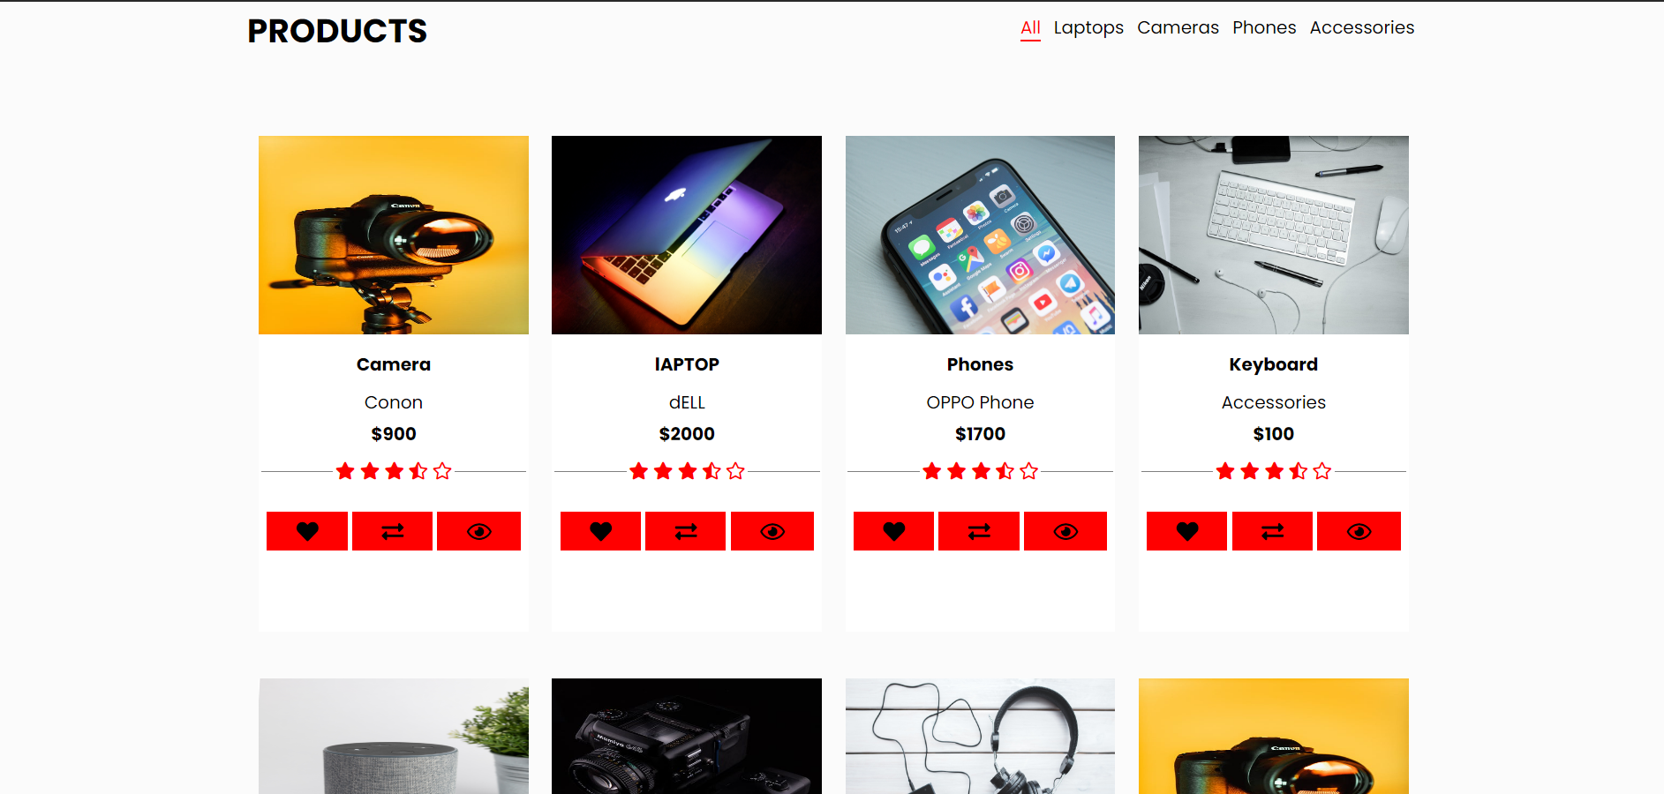
Home site

Slide 6
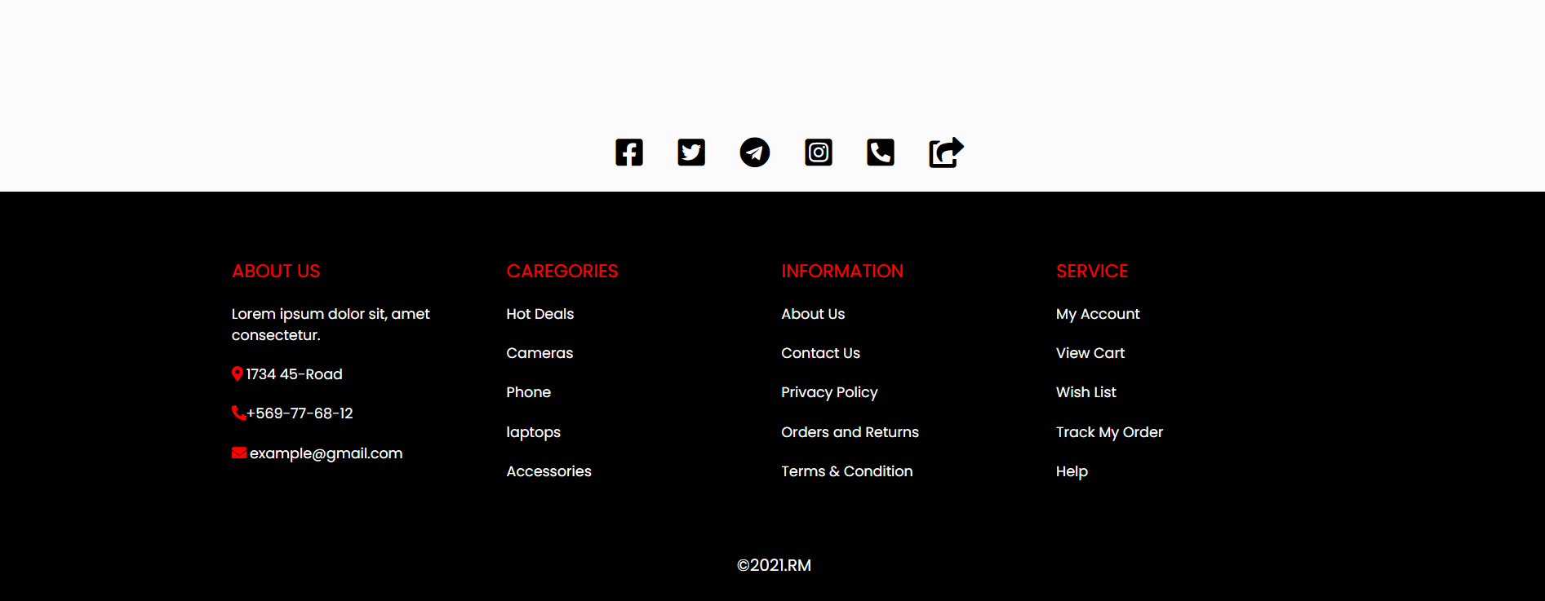
Home site

Slide 7
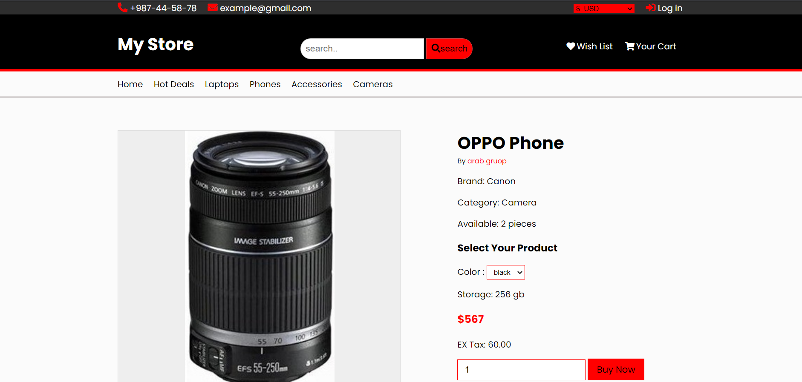
Product info

Slide 8
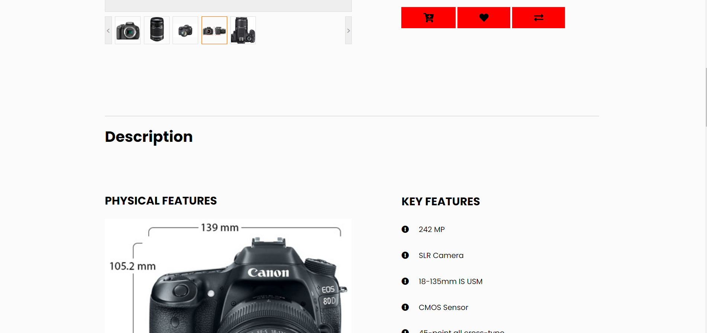
Product info

Slide 9
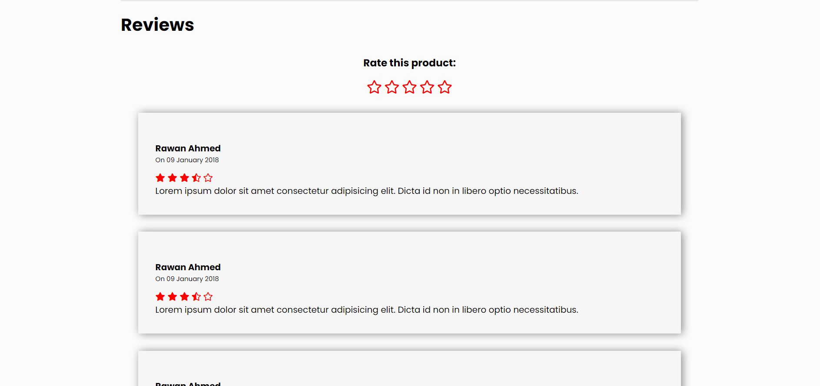
Product info

Slide 10
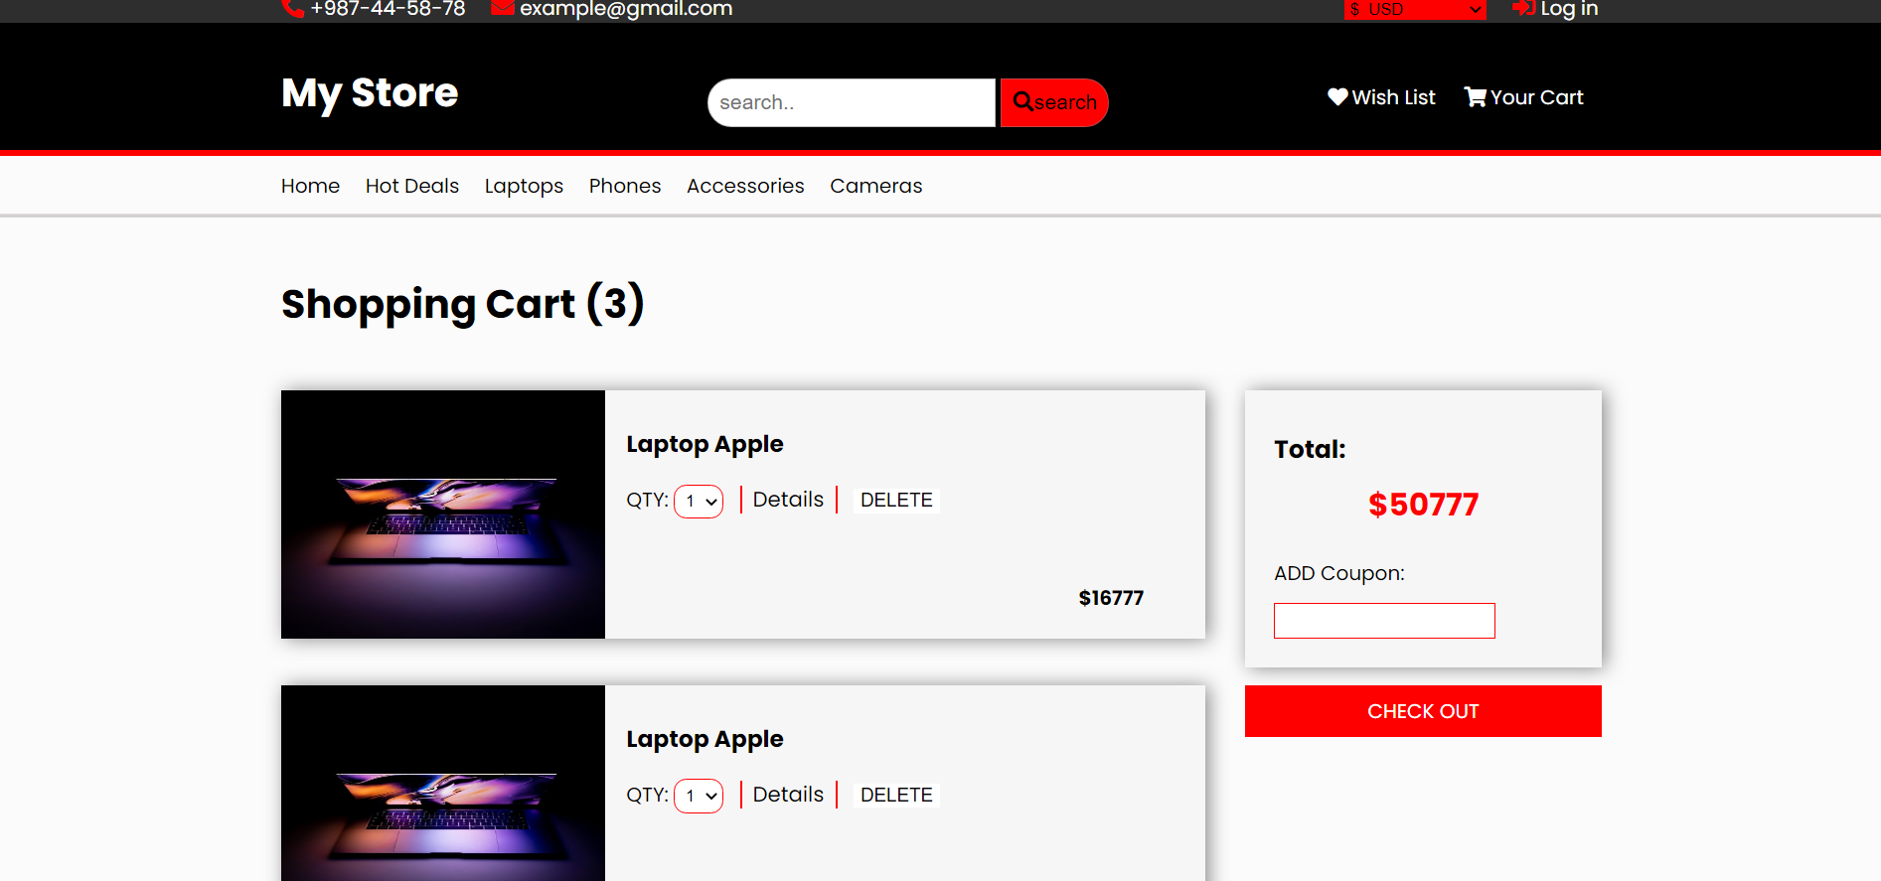
Cart

Slide 11
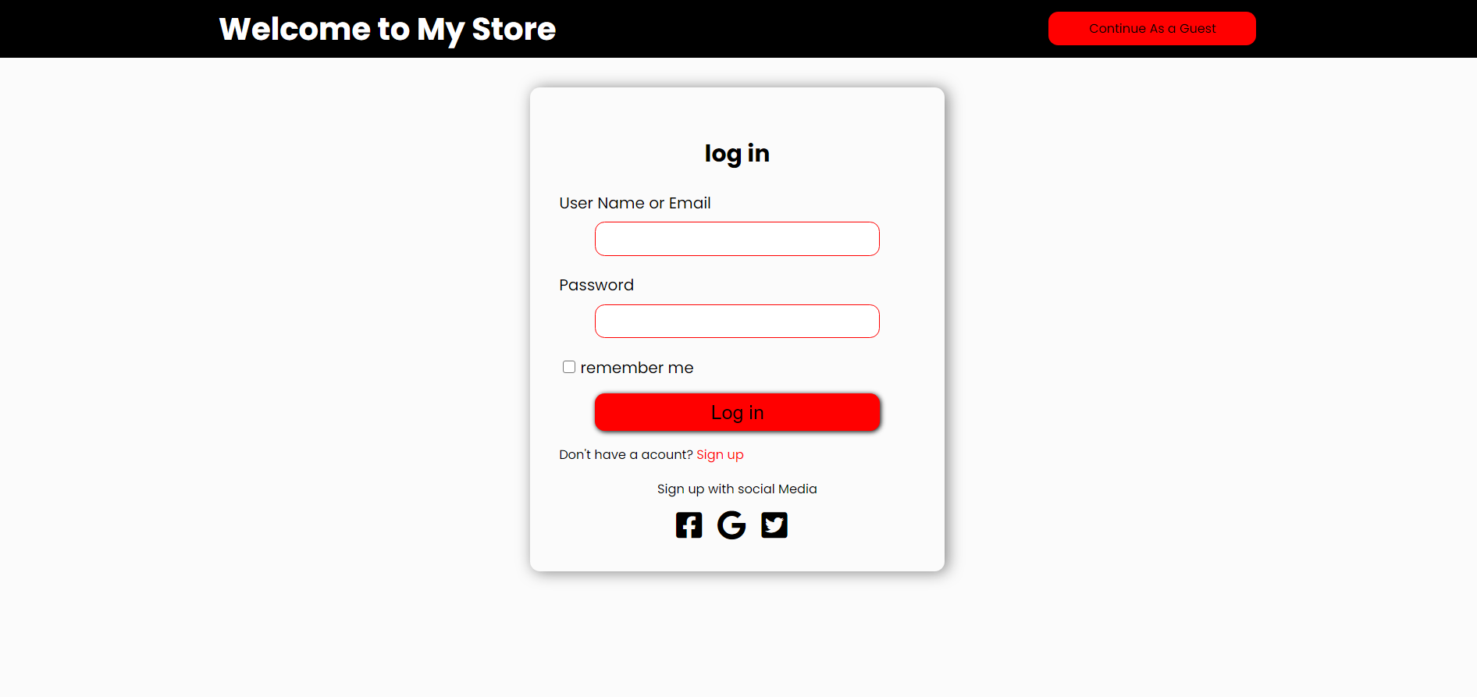
Log in

Slide 12
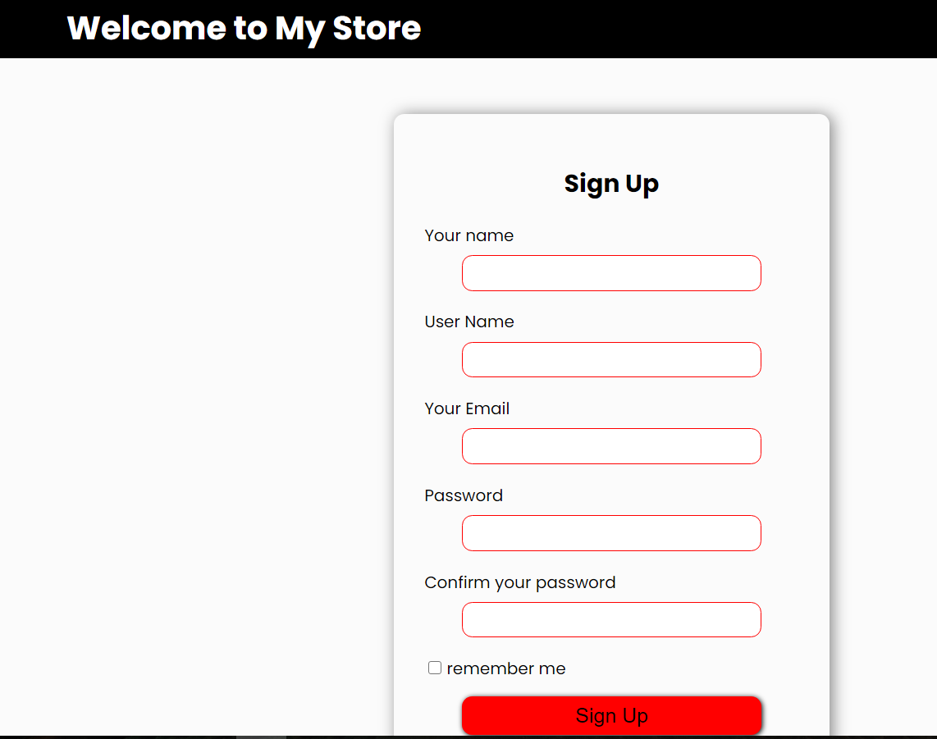
Sign Up

Slide 13
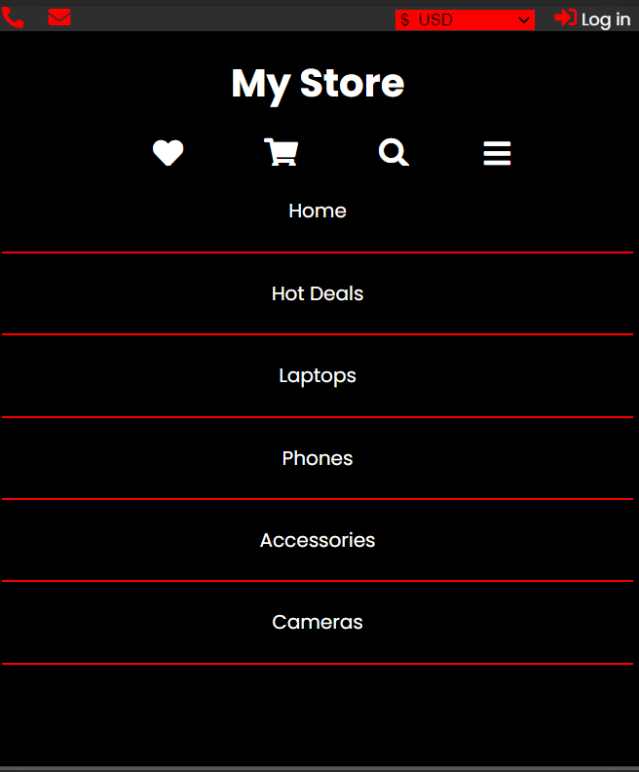
Responsive Home page

Slide 14
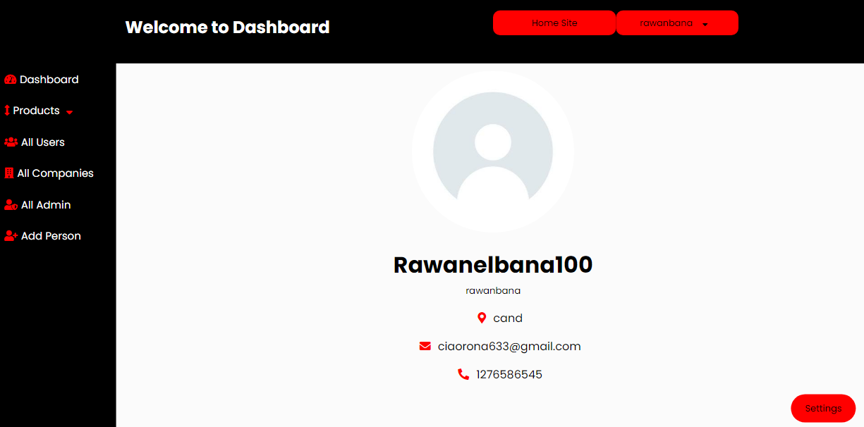
Admin profile

Slide 15
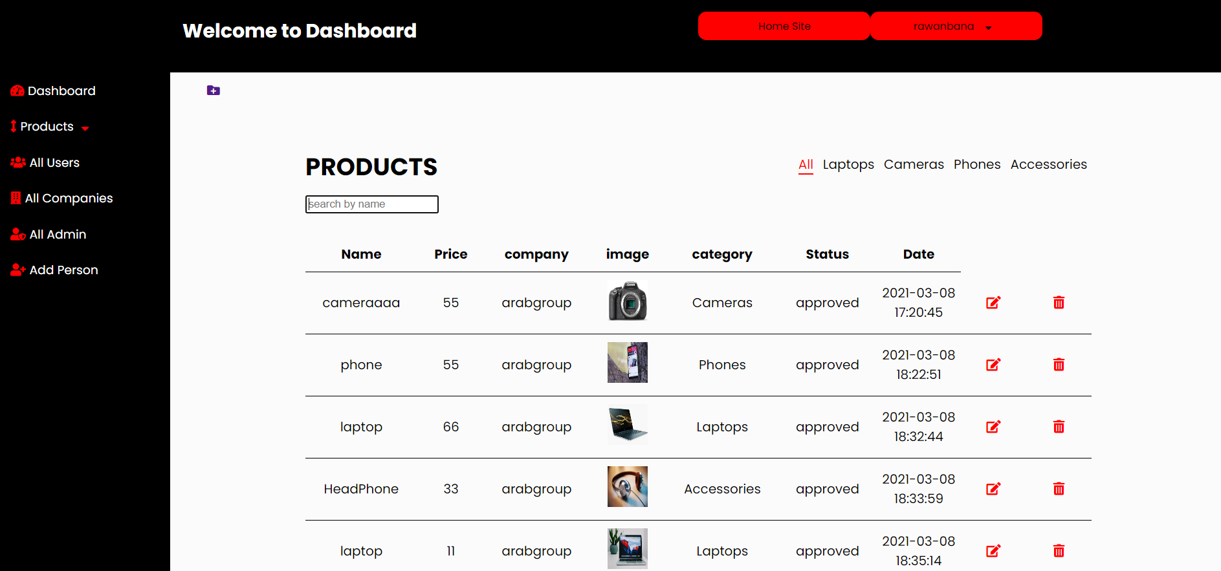
Admin Product

Slide 16
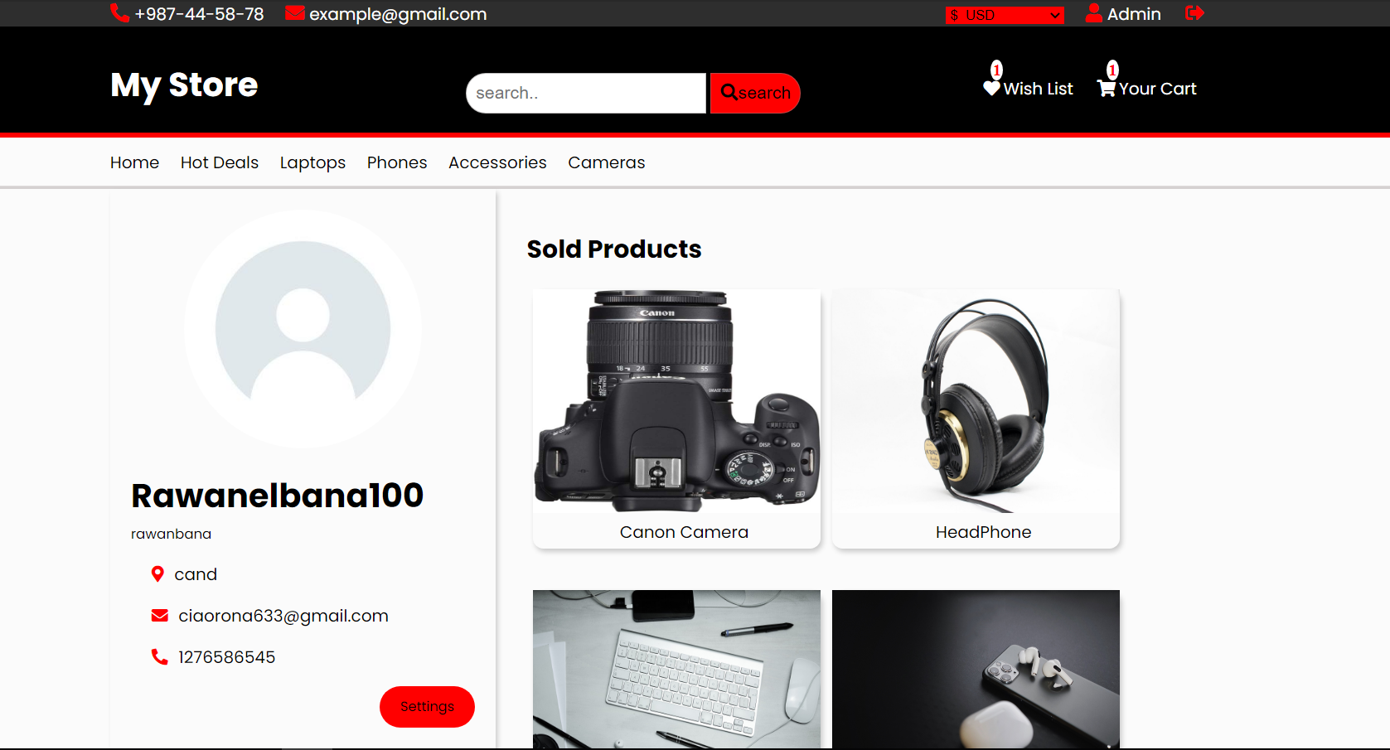
Profile user

Slide 17


